Slide 1

Overview Amazon.com
Name:Md.Amirul Islam
Batch:52
Department:Bangla
Date:14/12/2024

Slide 2
Brief Introduction to Amazon:
Amazon.com, Inc. is a multinational technology company founded by Jeff Bezos in 1994, originally as an online bookstore.
Over time, Amazon expanded to become a global leader in e-commerce, cloud computing (through Amazon Web Services), and digital streaming.
Headquarters: Seattle, Washington, USA
Mission Statement: "To be Earth's most customer-centric company, where people can find and discover anything they might want to buy online."
Global Presence: Amazon operates in more than 200 countries worldwide, with fulfillment centers and local retail operations.
Key Business Areas: E-commerce, Cloud Computing (AWS), Digital Devices (Alexa, Kindle), and Content Streaming (Amazon Prime Video).

Slide 3
Achievements of Amazon
Becoming a Global E-commerce Leader
Dominance in Cloud Computing
Innovation in Technology and Devices
Expansion into New Markets
Pioneering in Logistics and Delivery
Acquisitions and Expansions
Environmental and Social Impact Initiatives
Amazon Studios and Prime Video
Financial Success
Customer-Centric Innovation

Slide 4
Amazon Facts
Amazon offers its employees to learn English and other local languages through pre-paid classes.
As of 2022, the total number of granted patents to Amazon was 1,863.
Amazon consumers can donate to charities when they buy on the platform
Initially, Amazon was launched as an Auction site in 1999.
Amazon used to hold its meetings at Barnes and Noble.
The eCommerce website first sold its first book in 1995.
During the initial days of Amazon, every time the platform made a sale, the employees used to ring a bell.
In 2020, Amazon recorded 1.271 million employees across the globe.

Slide 5
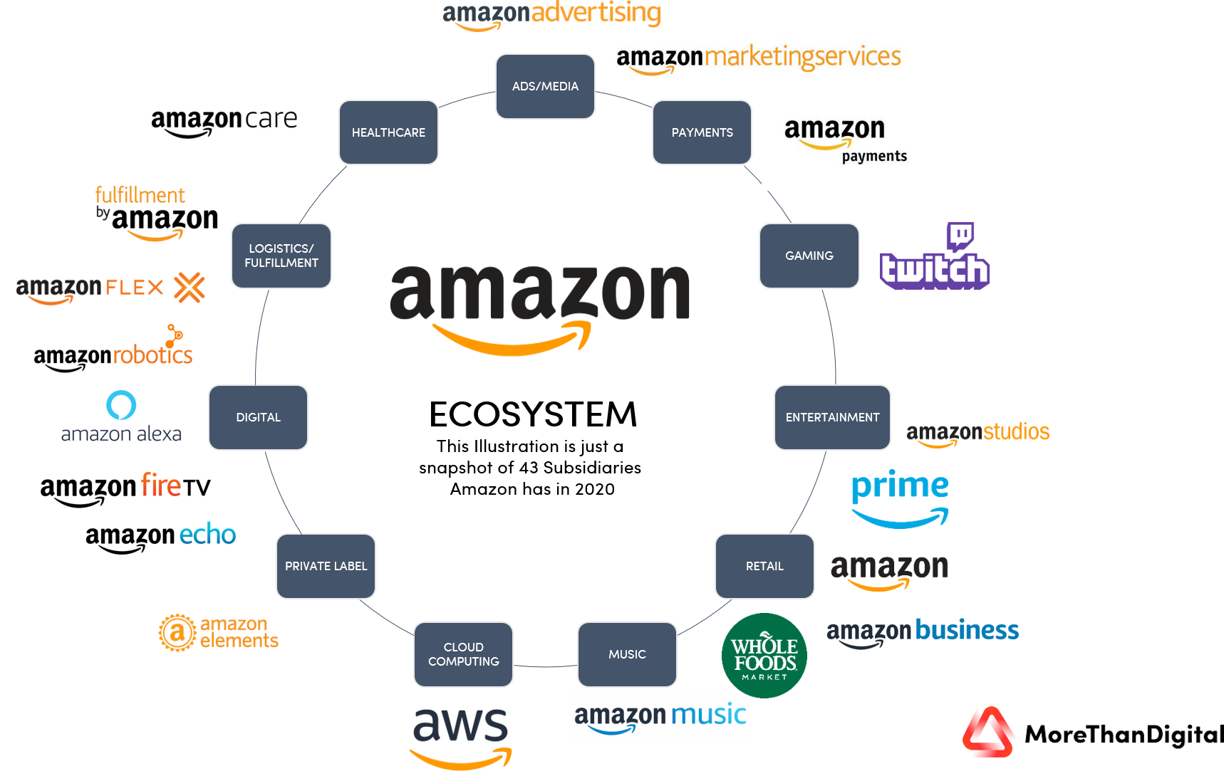
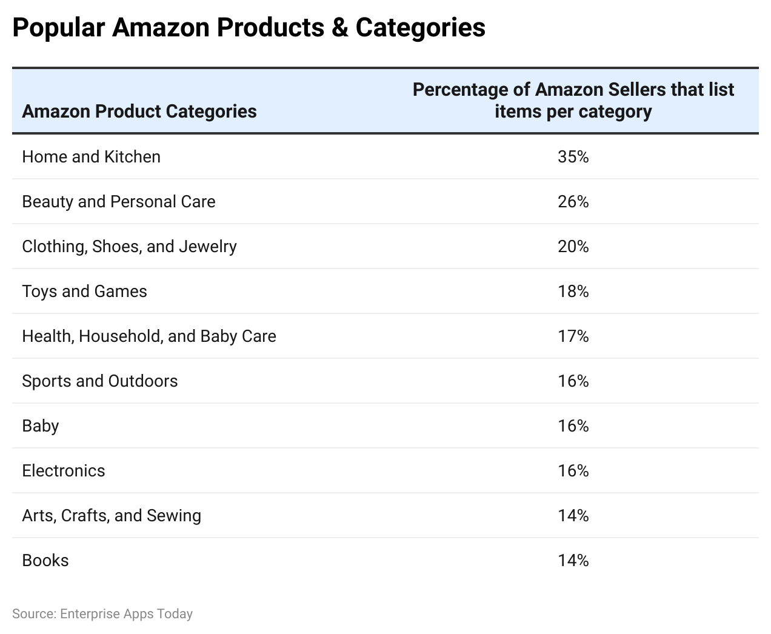
Amazon ecosystem
Amazon Statistics by the available percentage of products

Slide 6
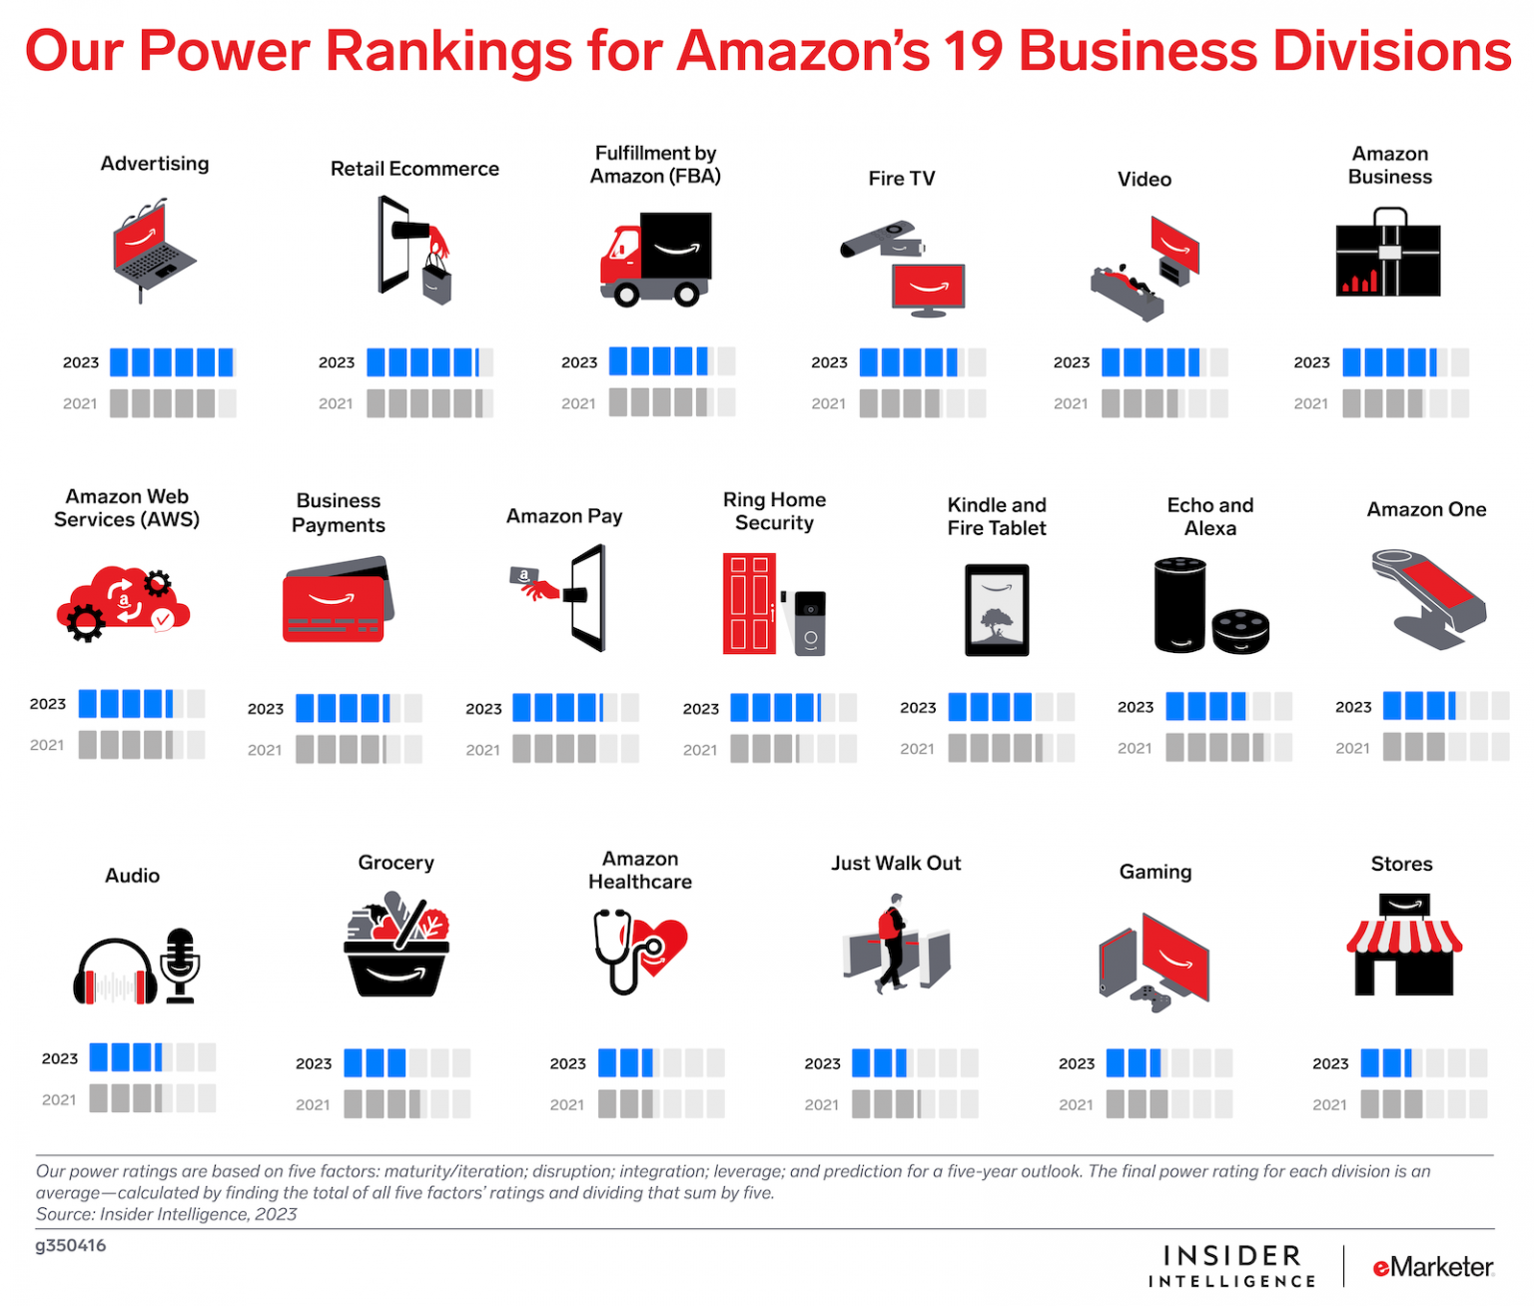
Amazon’s Top Ranking Business Divisions in 2023

Slide 7
Products/services
Key Products:
Amazon Marketplace: A platform where third-party sellers offer a wide range of products, from electronics to clothing.
Amazon Echo & Alexa: Smart speakers and voice-controlled assistants, integral to Amazon's foray into smart home technology.
Kindle: Amazon's e-reader device, revolutionizing the digital book industry.
Amazon Fire Devices: Including tablets, streaming sticks, and smart TVs.
Amazon Fresh & Whole Foods: The company’s expansion into the grocery and food delivery business.
Key Services:
Amazon Prime: A subscription service offering benefits such as fast shipping, streaming video and music, exclusive deals, and more.
Amazon Web Services (AWS): Cloud computing services providing storage, computing power, machine learning, and more for businesses.
Amazon Prime Video: A streaming service offering movies, TV shows, and original content.
Amazon Music: Streaming service offering music content with a subscription.

Slide 8
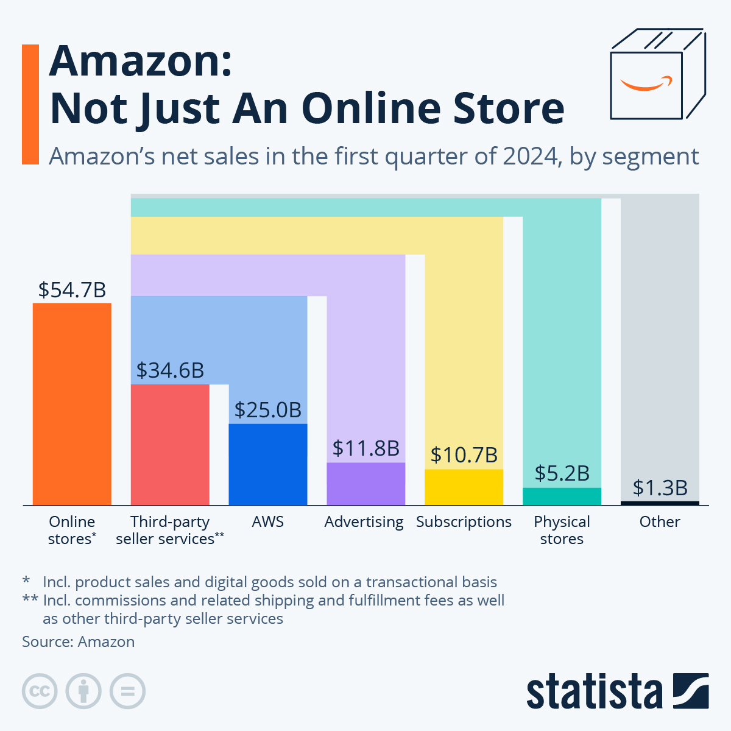
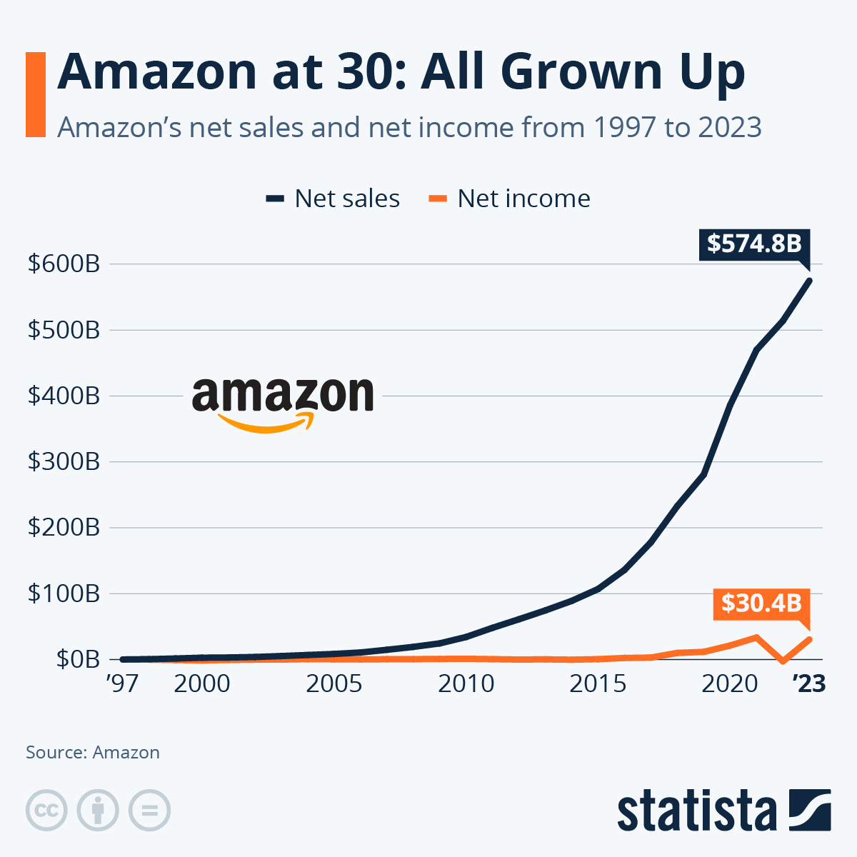
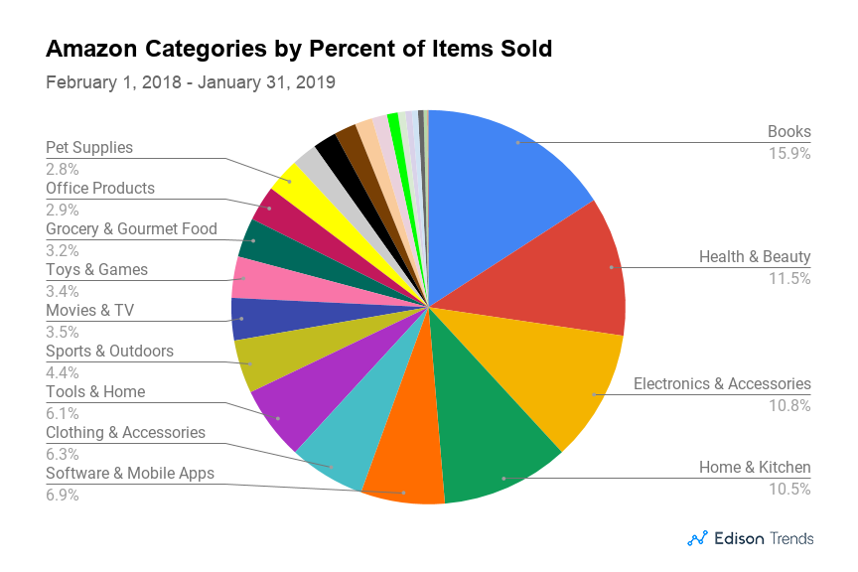
Data analysis
Amazon net sales and income

Slide 9
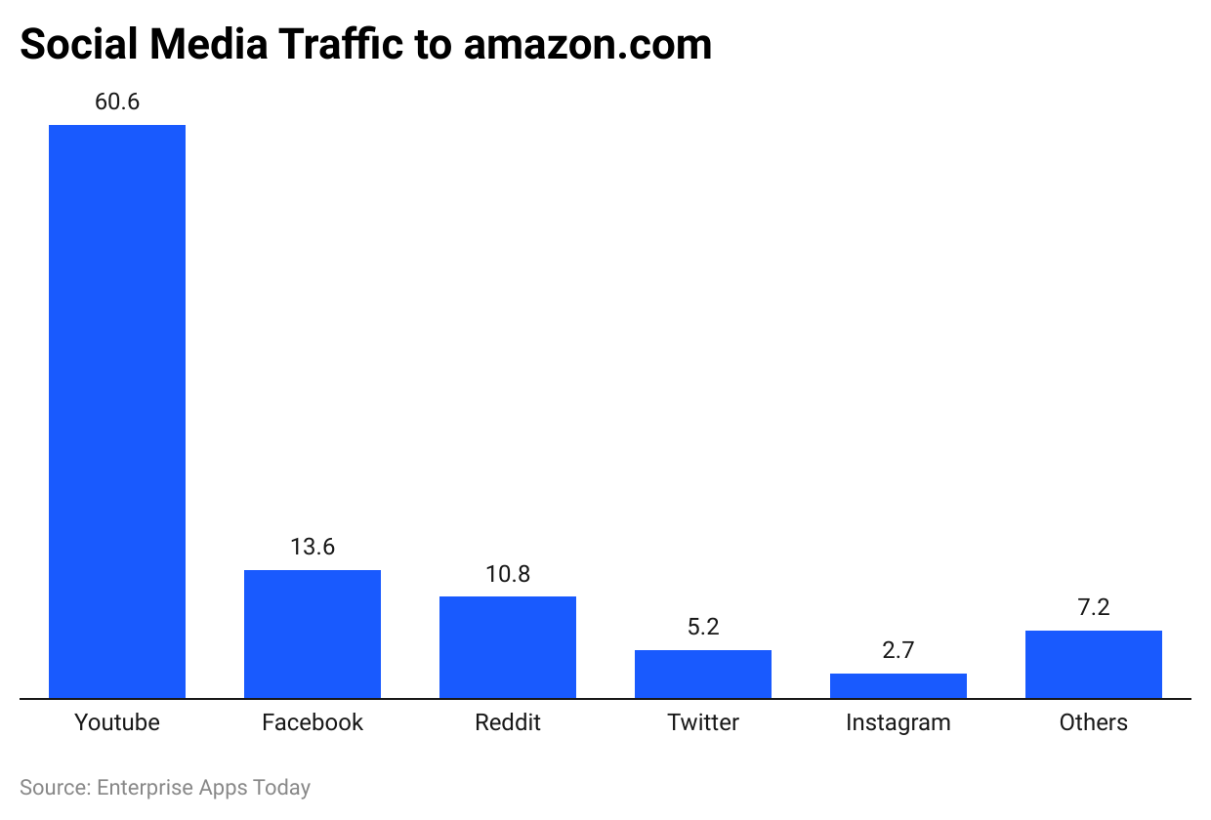
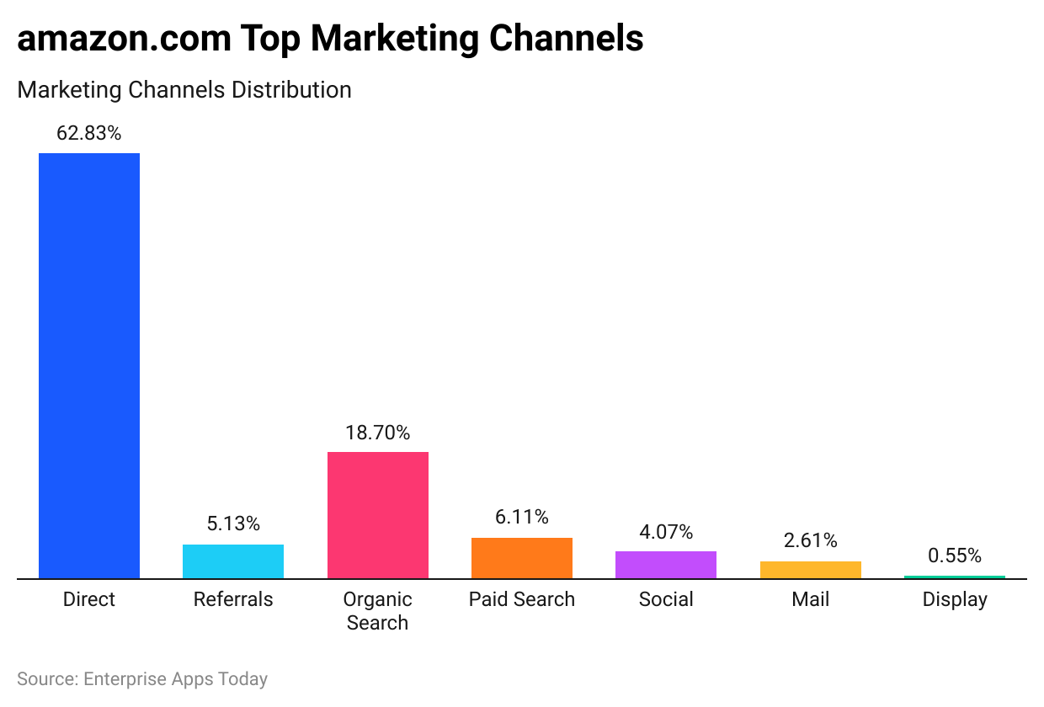
Amazon Statistics by various products/services
Amazon Statistics by Social Media Referral Distribution
Amazon Statistics by Marketing Channels Distribution

Slide 10
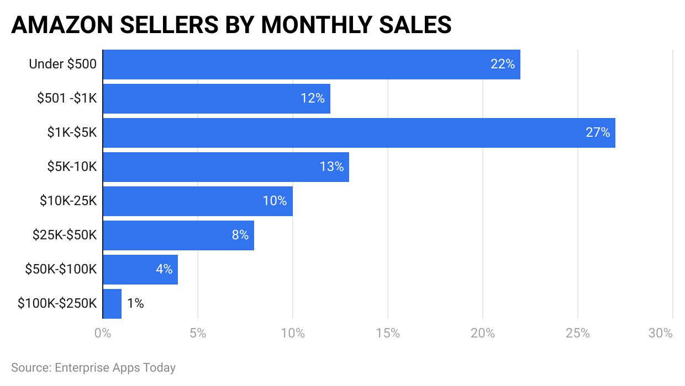
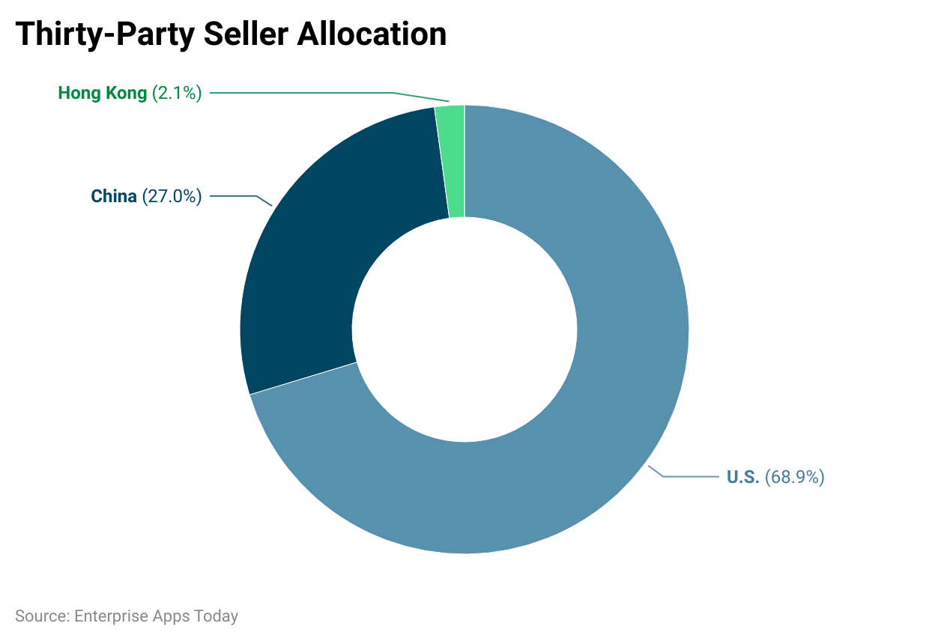
Amazon Statistics by Seller
80% of the sellers on Amazon sell on other platforms as well.
Amazon platform has more than 6.4 million sellers registered spread across the world out of which 1.5 million are active.
Every day Amazon registers 3,700 new sellers on the platform.
83% of the sellers registered on Amazon sell on Prime shipping.
By seller’s monthly sale
The majority of the third-party sellers on Amazon.com are located in the United States of America at 68.9%, followed by China at 27.0% and Hong Kong at 2.1%

Slide 11
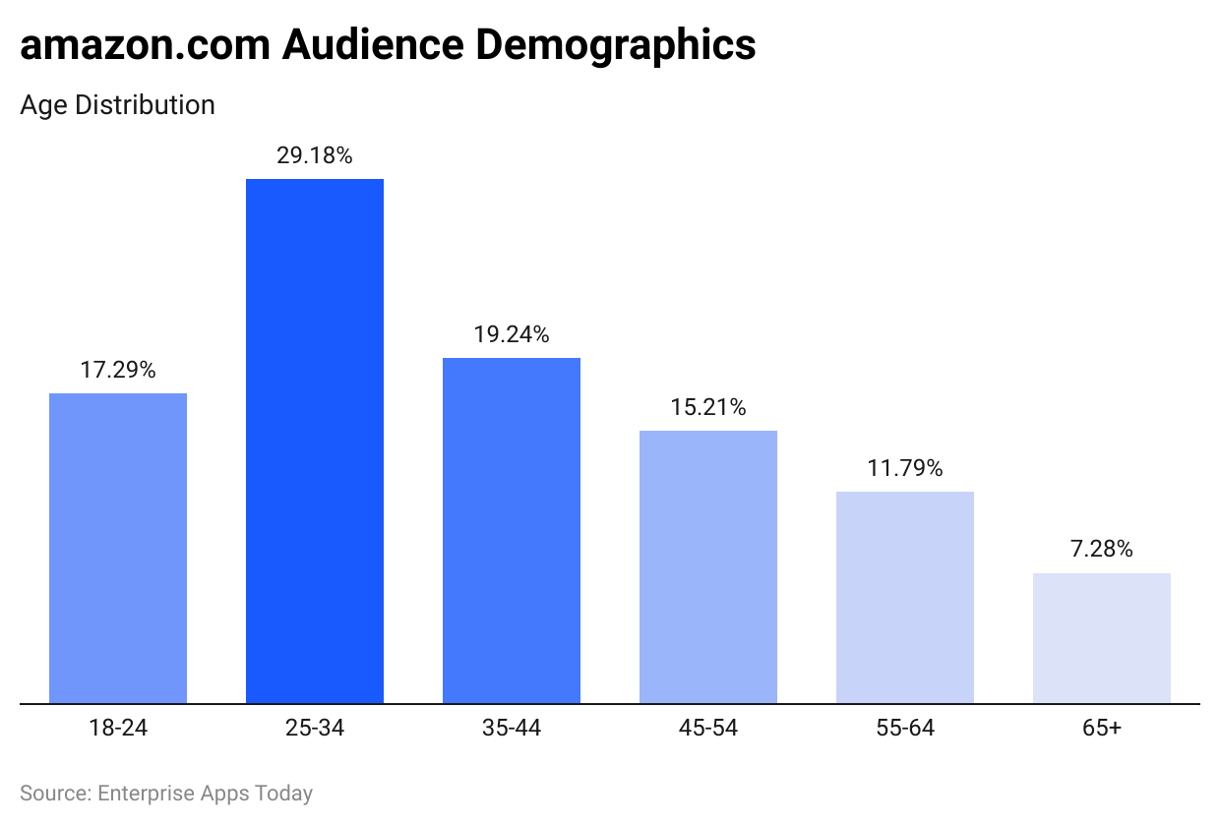
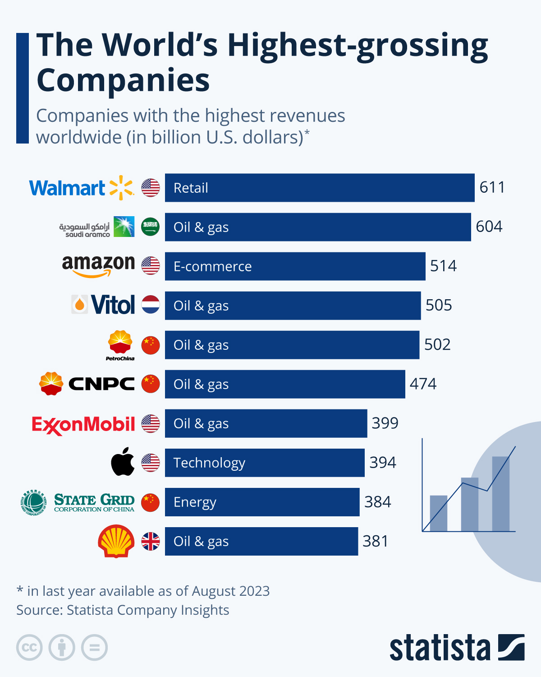
Amazon Statistics by Demographics
World’s Highest grossing companies as of August 2023

Slide 12
conclusion
Amazon continues to innovate and expand its offerings, maintaining its leadership in e-commerce, cloud computing, and digital services.The company’s ability to diversify into various business segments has helped it maintain robust growth despite competition.Moving forward, Amazon’s emphasis on AI, automation, and expanding global logistics networks will likely drive further success.

Slide 13


